Slide 1
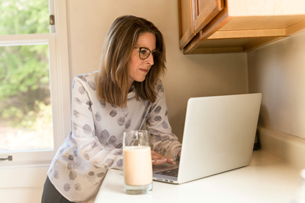
Jenny Lewis
“I don’t want to be in front of the computer browsing for hours. I just want to search for what I want and buy it quickly”
Marketing Manager
Technology
She is uses the computer to generate reports and communicate via email and messages with coworkers. She is PC savvy and has high speed internet available at home and at work. She users to browse the web for about one hour in her free time. Uses a tablet when at home for browsing and buying online.
Goals
Buying only toys for her grandkids that have good reviews.
Don’t want to waste time browsing online.
Find everything in just one place and maybe get some other toys related for her kids.
Get something that has good quality and good price.
56 years old
Married
Grandmother of two childrens
Salary: $175,000
Undergrad: BA Marketing.
Grad: Masters in Economics.
Location: New Orleans, LA
Behaviors
Environment
Gets tired when using the web for more than an hour.
Can be influenced to buy if discounts are available.
Likes to buy everything from one store and at one time so everything gets home at the same time.
After the pandemic, she decides to work from home 3 days of the week. The other days, she goes to the office in the morning and work from home in the afternoons.

